Slide 1
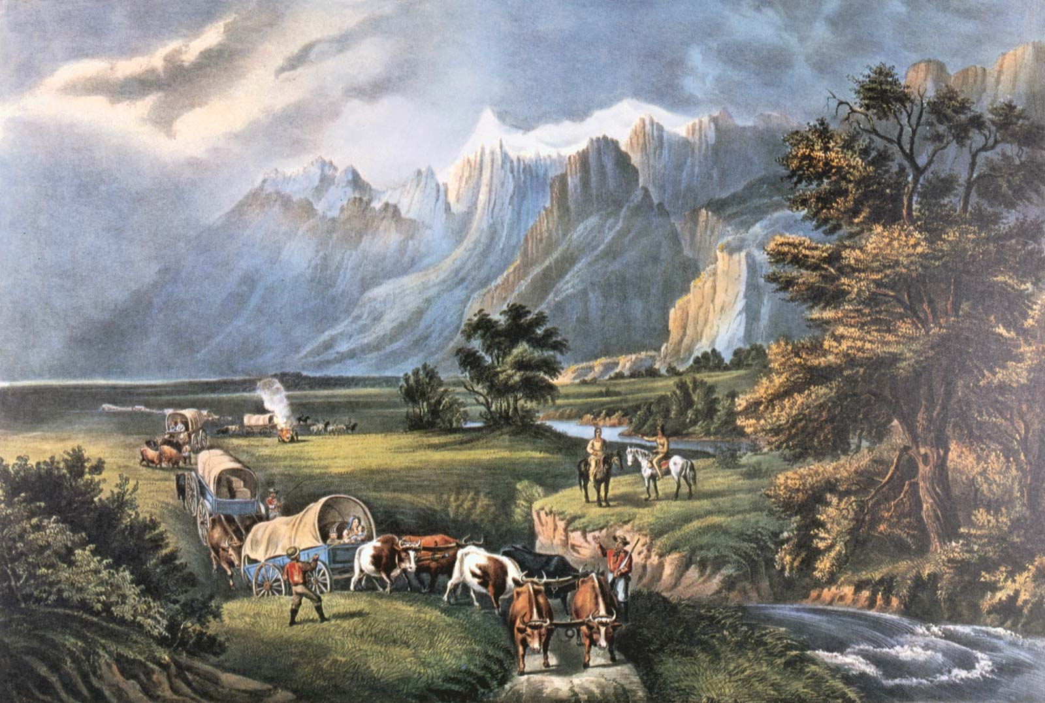
The Frontier

Slide 2
Learning Targets
I can analyze political issues such as Indian policies. (3A)
I can analyze economic issues such as the growth of railroads, farm issues, and the cattle industry boom. (3B)
I can identify the major eras in US history from 1877 to the present (2A)
I can describe the characteristics of major eras from US history from 1877. (2A)

Slide 3
Warm Up
Think about the West
Write down 5 things you know about the West or associate (connect) with it
Farming
Railroads
Trains
Cattle
Horses

Slide 4
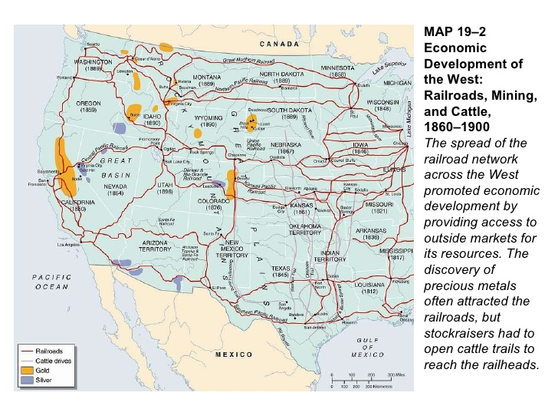
Notes:
Click "Draw", then click one of the pens.
Add in cattle drive lines, mines, the Transcontinental Railroad, and highlight the Great Plains as we move through the notes
It does NOT need to be exact, just try your best

Slide 5
The Frontier Lecture
What is Manifest Destiny?
The idea that the US was ordained (commanded or blessed by God) to settle the land from East to West (“From Sea to Shining Sea”)

Slide 6
The Frontier Lecture
Where did Americans go to mine for gold?
(+ the years)
Many Americans were lured to the West by the chance to strike it rich by mining gold
Who worked in mines? Where were 1/3 of workers from?
Miners from the US, France, Germany, Ireland, Mexico, China.

Slide 7
The Frontier Lecture
Which two cities began as mining towns?+
Denver
Colorado Springs

Slide 8
The Frontier Lecture
How were railroads companies able to expand west?
The government provided land and land grants
What railway connected the East Coast with the West Coast?
Central Pacific
Union Pacific

Slide 9
The Frontier Lecture
Who was used to build the railroads?
Immigrant workers
Where were they usually from?
China, Ireland, Mexico, Africa
What spot completed the Transcontinental Railroad?
Promontory Point joined the railroads with a golden spike
05/10/1869

Slide 10
The Frontier Lecture
Why were time zones created?
So that railroad schedules could be coordinated

Slide 11
The Frontier Lecture
How did cattle ranches begin?
Cattle started to come together and roam around Texas.
Where were most cattle ranches located?
Texas

Slide 12
The Frontier Lecture
How were cows moved north to be processed?
Created cattle drives
What invention prevented cows from roaming freely?
Barbed wire

Slide 13
The Frontier Lecture
What is a cattle town?
A place for cattle to be loaded onto trains and ship them to markets in the East
What are two examples of cattle towns in Texas?
San Angelo
Fort Worth

Slide 14
The Frontier Lecture
What are refrigerated packing plants?
A place for cattle processing
Name 3 examples of refrigerated packing plants.
Armour
Swift
Libby

Slide 15
The Frontier Lecture
Name 2 reasons why the cattle boom ended.
Bitter winter
Extreme summer

Slide 16
The Frontier Lecture
What did the Homestead Act of 1862 do?
The government fives 160 acers of land for farming
Which part of the country did farmers move to?
People settled in the west
People that moved west through the Homestead Act were called what?
Homesteaders

Slide 17
The Frontier Lecture
Why did homesteaders live in sod homes?
They didn’t have a choice/they didn’t have the resources to build lumber homes

Slide 18
Reflection
What kind of relationship did farmers and railroad companies have?
I think they are going to bad relationship.

Slide 19
Wrap Up
Identify 3 pull factors that drew people West
Homestead act
Railroad jobs
Mining jobs
Brainstorm: why did people leave the East coast?
People needed jobs

Slide 20
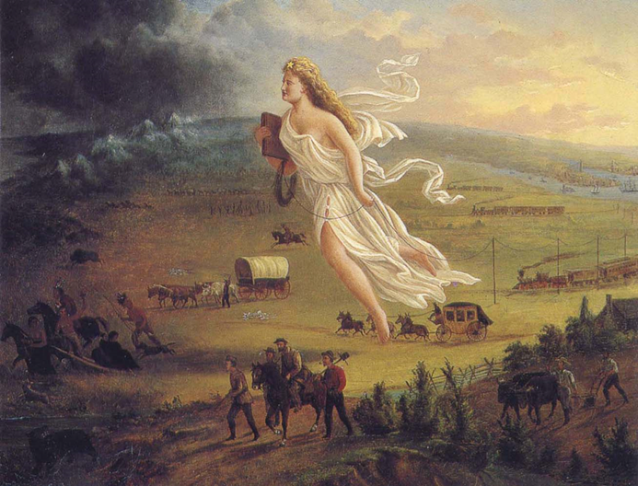
Warm Up
Identify 3 details that represent important historical ideas
Explain how those details represent important historical ideas
The people walking represents people going from the east to the west
The horses represent

Slide 21
The Frontier Lecture
What happened to Indians as Americans moved West?
They get kicked off their land and put on reservations
Describe the impact of westward expansion on the bison/buffalo population.
The buffalo were hunted and became ectinct

Slide 22
The Frontier Lecture
Indian Policy Name | Purpose | Effect
Civilization Fund Act (1819) | Encouraged schools and missions to “educate” Indians in the ways of the white man | Divided the nations into social classes; caused the Indian culture to begin to disappear.
Indian Removal Act (1830) | Move Indians in the eastern part of the US to lands west of the Mississippi River. | Trail of Tears –many died along the way.
Dawes Severalty Act (1887) | Divided tribal land | Failure-the change of lifestyle and culture was too dramatic and drastic.

Slide 23
The Frontier LECTURE
What is assimilation?
Accepting white man culture.

